Slide 1

AGB1211 – DESIGN THINKING
Department of Artificial Intelligence and Data Science
Academic Year: 2024 – 2025 (Odd Semester)
Year : II
Semester : III
Section : A
Date : 05/12/24
PRESENTED BY
1. ABDUL RAHEEM F
2. ABI VARSAN P
3. AATHIL AHAMED H
4. AARYA A

Slide 2
TRANSPORT TRACKING

Slide 3
Problem Identification
Parents and school authorities often face challenges in ensuring student safety during school commutes. Lack of real-time updates leads to delays, confusion, and safety concerns.

Slide 4
Objective
The primary objective of the School Transport Tracking System is to ensure the safety, efficiency, and reliability of school transportation. By leveraging GPS technology, real-time tracking, and automated communication systems, the system aims to address key challenges faced by schools, parents, and students. Specifically, the objectives include:
Enhancing Student Safety: Provide real-time bus location updates, implement geofencing for safety zones, and monitor driver behavior to ensure secure transportation.
Facilitating Effective Communication: Enable seamless communication between parents, school administrators, and bus drivers through real-time notifications and alerts.
Emergency Handling: Equip the system with tools to quickly respond to breakdowns, route deviations, or accidents, ensuring rapid assistance and updates.
Building Trust and Transparency: Increase accountability and reliability by providing parents and administrators with live tracking and operational insights.

Slide 5
BrainStorming
KEYWORDS
PARENT NOTIFICATION
GPS TRACKING SYSTEM
REAL TIME ANALYSIS
BUS ARRIVAL NOTIFY
PARENT COMMUNICATION TOOLS
PUSH NOTIFICATION
REAL TIME GPS MONITOR
SATELLITE VIEW
SPEED MONITOR
REAL TIME BUS TRACKING
SAFETY & SECURITY
LIVE MAP TRACK
LOCATION UPDATE
ETA PREDICTION
STUDENT SAFETY APP
SCHOOL BUS SECURITY
EMERGENCY RESPONSE
BUS DRIVER MONITOR
LIVE MAP TRACK
LOCATION UPDATE
ETA PREDICTION
LIVE MAP TRACK
LOCATION UPDATE
ETA PREDICTION

Slide 6
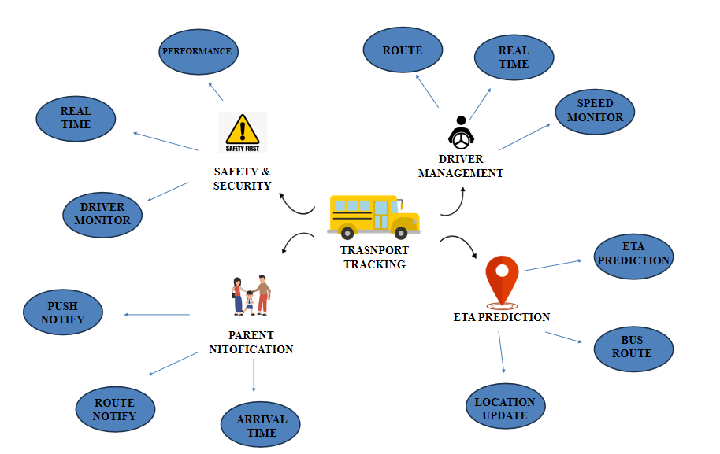
Mind Map

Slide 7

Primary Research
Survey Insights:
Conducted surveys with parents, students, and bus drivers to identify common pain points.
80% of parents need efficiant app to track
60% of drivers report issues with unclear routes or last-minute changes.
Field Observations:
Observed the dailObserved the daily bus commute process in schools.
Identified delays caused by traffic, route mismanagement, and communication gaps.
y bus commute process in schools.
Identified delays caused by traffic, route mismanagement, and communication gap
8 OUT OF 10
Customers are pleased
with our services.
Observed the daily bus commute process in schools.
Identified delays , route mismanagement, and communication gaps.

Slide 8
Secondary Research
EXISTING SOLUTIONS IN THE MARKET:
Analyzed apps like Bus Where and MySkoolBus
Communication gap
STATISTICS ON SAFETY CONCERNS:
70% of parents prefer real-time tracking systems for child safety
Rise of GPS-based systems in school transport management.
Increasing adoption of mobile apps for parent-teacher communication.
TECHNOLOGY TRENDS:

Slide 9
Proposed Work
Real-Time Tracking : Integrate with a GPS service or a third-party API to display live locations on a map.
Use Adalo's map components to visually track bus routes.
Parent Notifications : Utilize Adalo's notifications to send alerts for bus arrival and delays.
Provide SMS options for parents who may not actively use the app.
Driver Dashboard : Add a separate interface for drivers to start trips, report issues, or send emergency alerts.
Student Attendance : Add a feature for marking attendance when students board and deboard using manual entries.

Slide 10
List of Modules
Login Module
Parent Module
Driver Module
Student Module

Slide 11
Module 1 Description
1) Login System Module :
The Login System is the gateway to the app, ensuring secure and role-based access for parents, drivers, and school administrators. Each user logs in with unique credentials, and the system verifies their role to grant access to relevant features. It provides a simple, secure way to protect data while offering personalized experiences for different users.

Slide 12
Module 2 Description
2) Parent Module
Features:
Real-Time Tracking: View the bus location on a live map to know the current status and estimated arrival time.
Notifications:
Alerts for bus arrival at the pick-up/drop-off point.
Notifications for delays or emergencies.
Communication: A chat or call feature to connect with the bus driver or school administration.
Purpose: Provides parents peace of mind through constant updates on their child's safety and location.

Slide 13
Module 3 Description
3) Driver Module:
Features:
Attendance Tracking:
Manual checklist for student boarding/deboarding.
Instant Notifications:
Notify parents about delays, emergencies, or route changes.
Update admin about any issues on the route.

Slide 14
Module 4 Description (Cont..)
4) Student Module:
Features:
Arrival Notifications: Alerts when the bus is near, so students are ready at the stop
Check bus updates
view bus
track bus

Slide 15
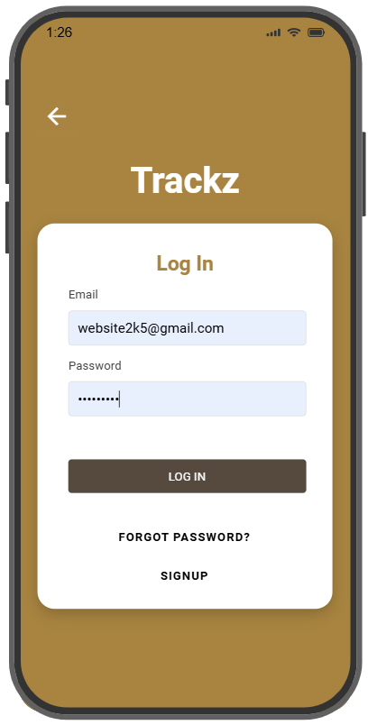
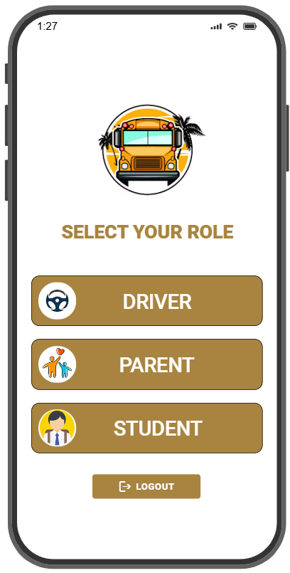
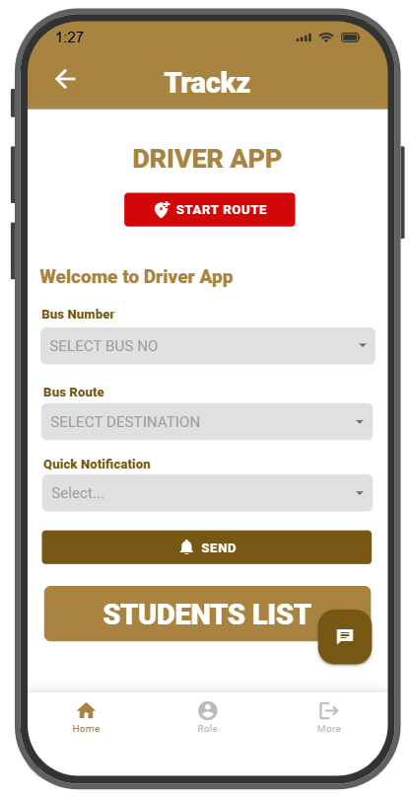
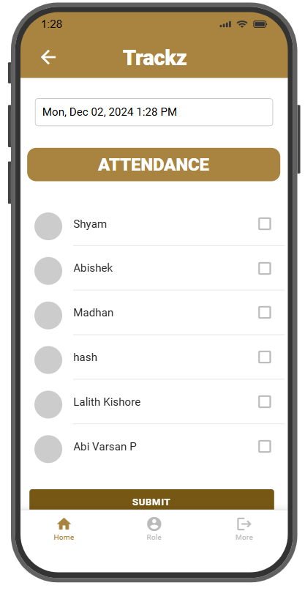
Results

Slide 16
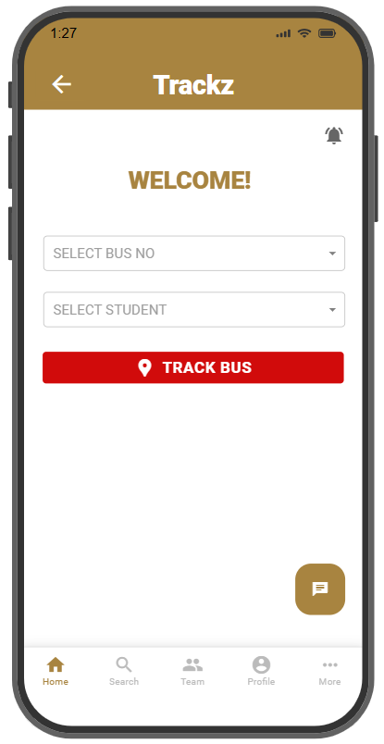
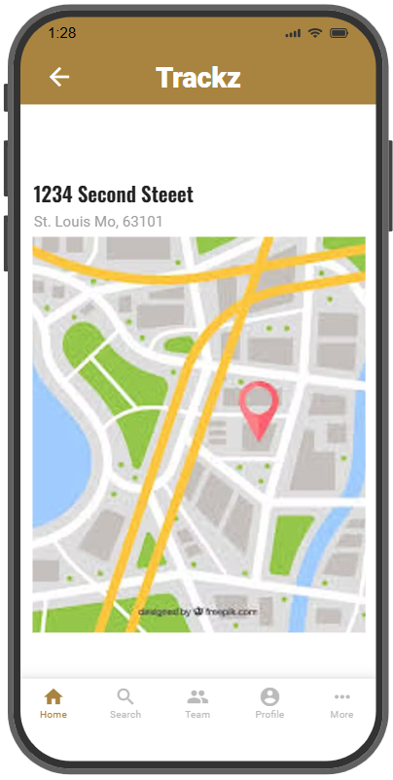
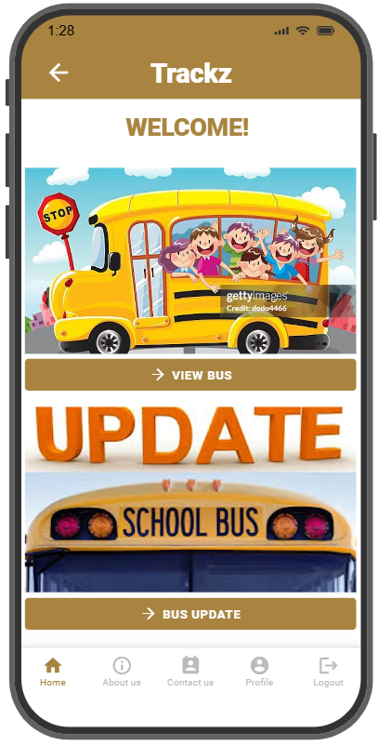
Results

Slide 17
Conclusion
The implementation of a School Transport Tracking System is a significant step toward enhancing the safety, efficiency, and reliability of school transportation. By integrating modern technologies such as GPS, cloud platforms, and mobile applications, this system offers real-time tracking of school buses, providing parents, school administrators, and drivers with transparent, up-to-date information. This not only addresses the common concerns of parents about their children’s safety but also ensures timely pick-ups and drop-offs, reducing the uncertainty associated with traditional transportation methods.

Slide 18
Thank You
Any queries???

